Slide 1
Blockchain Credentials and Introduction to Ethereum
19 Feb 2025
Handy Bong (handy@hku.hk)

Slide 2
Outlines
Why use blockchain?
Blockchain credentials
Introduction to Ethereum
Mini workshop: using blockchain explorer with Etherscan
Basic features of blockchain explorer
Read blockchain transaction

Slide 3
Why use blockchain?
Blockchain properties:
Decentralized
Transparent
Immutability
Public?
What data safe to put into public space? (encrypted or plain text)
Do we need monetary feature? (payment system)
Private/permissioned?
Do we need monetary feature?
Do we want full ownership of data?
Can we do some trade-off?
L2-blockchain: start slightly centralized (decentralize on architecture)

Slide 4
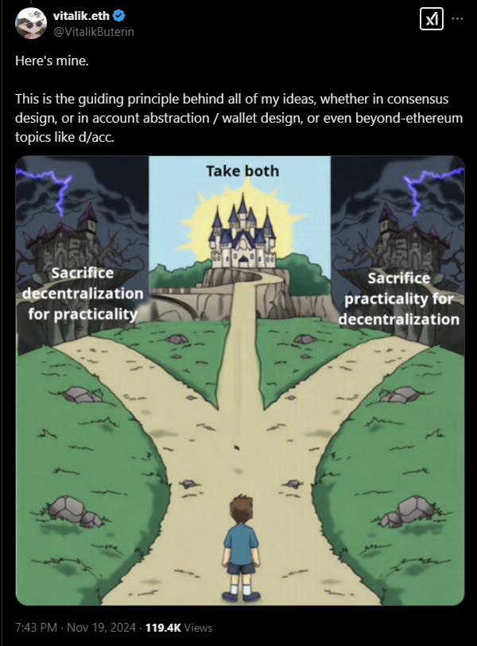
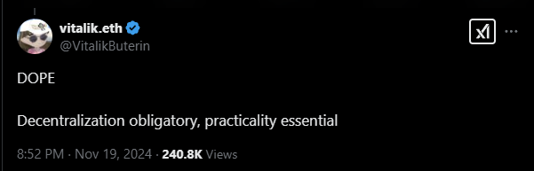
Decentralization Obligatory

Slide 5
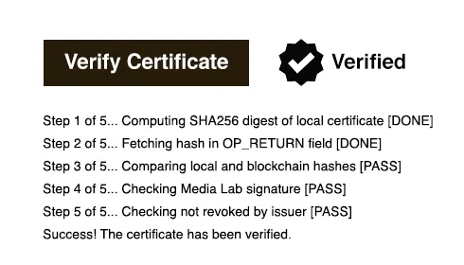
Blockchain Credentials
Blockcerts
Open standard for blockchain credentials.
Open source, every one can verify credential.
Why we need blockchain credential?
Decentralize verification
Ownership of credential
Prevent fraud
Require credential issuer to disclose their signature.

Slide 6
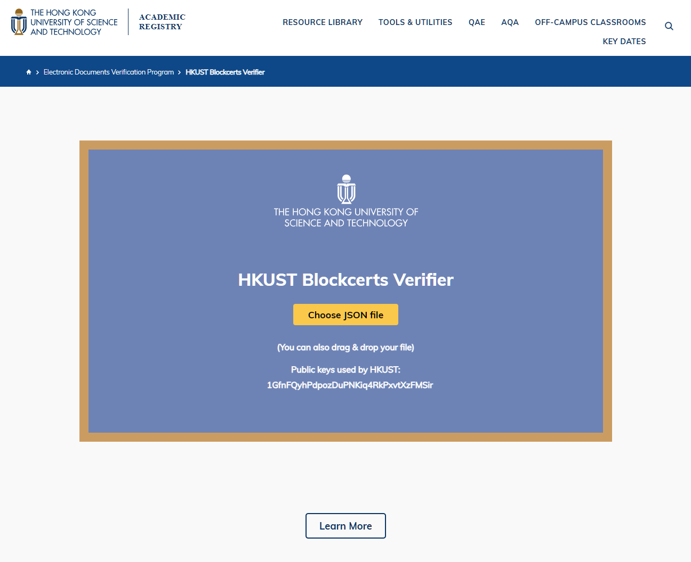
HKUST Blockcert

Slide 7
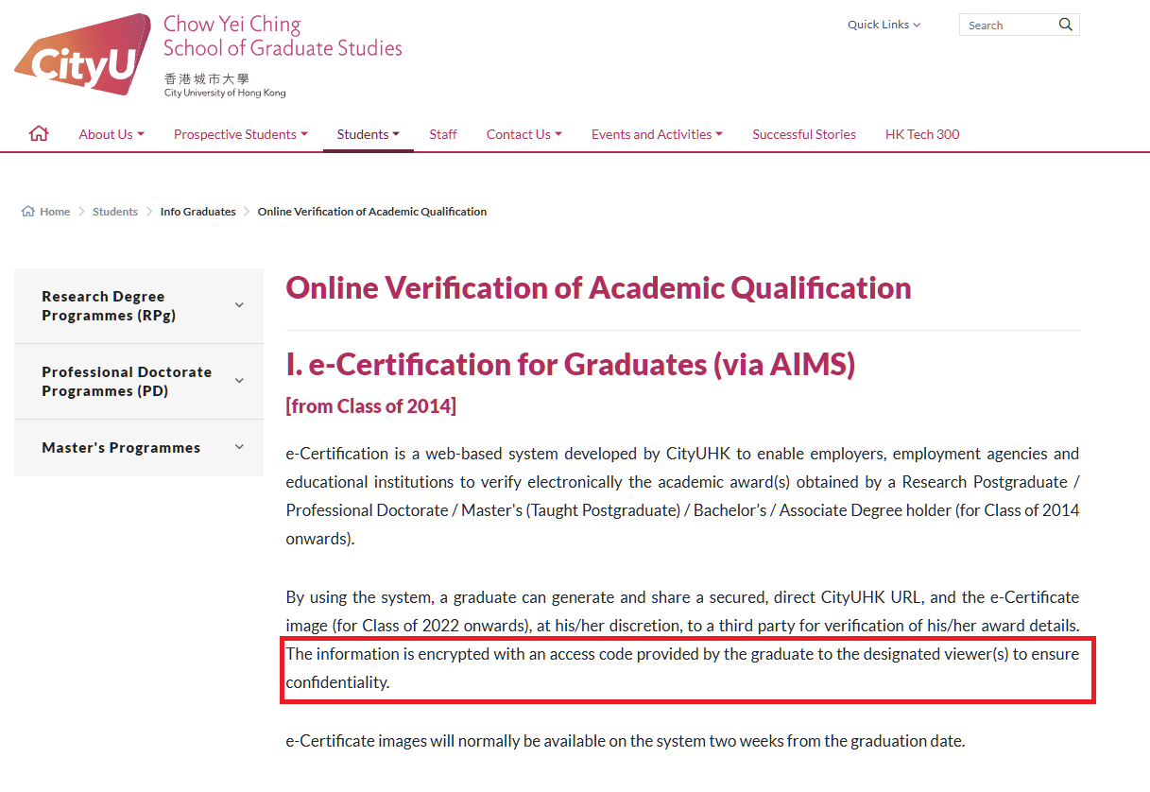
CityU e-Certification

Slide 8
What the challenges?
How can certificate holder prevent leak of access?
In HKUST Blockcert and CityU, anyone with JSON and access code can view the certificate.
Decentralize verification
Decentralize certificate issuing
Scope
Type of academic institution: university, secondary school?
Ideal solution:
Use blockchain account (wallet) to send “credentials”
Can everyone manage blockchain account?
Trade-off?
Credentials hold by trusted platform

Slide 9
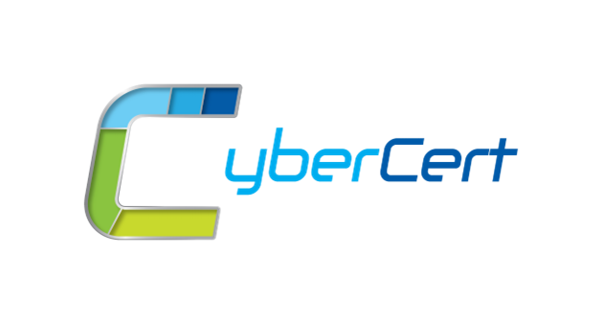
Introduce
CyberCert is Cyberport initiative for e-Certification platform for local academic institution.
Currently launch for limited users.
Features:
Certificate holder can track and manage access restriction to share certificate.
Academic institution can issue certificate through the platform.

Slide 10
CyberCert Design Overview
Decentralization on roadmap
Getting academic institution on-board
Permissioned blockchain: Hyperledger
Full ownership of data for privacy. Certificate may have private information.
Not require any monetary features.
Open source.

Slide 11
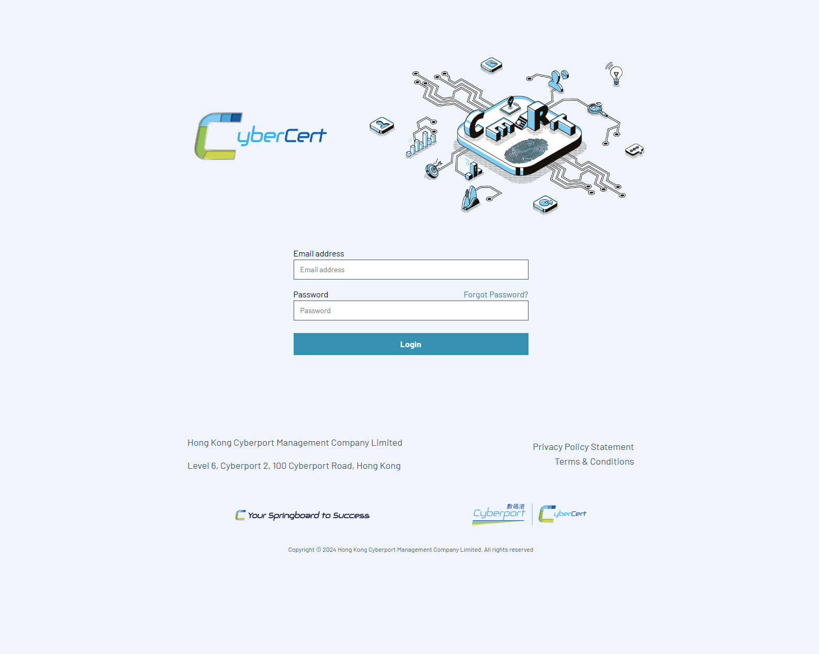
CyberCert Homepage
https://cybercert.cyberport.hk/

Slide 12
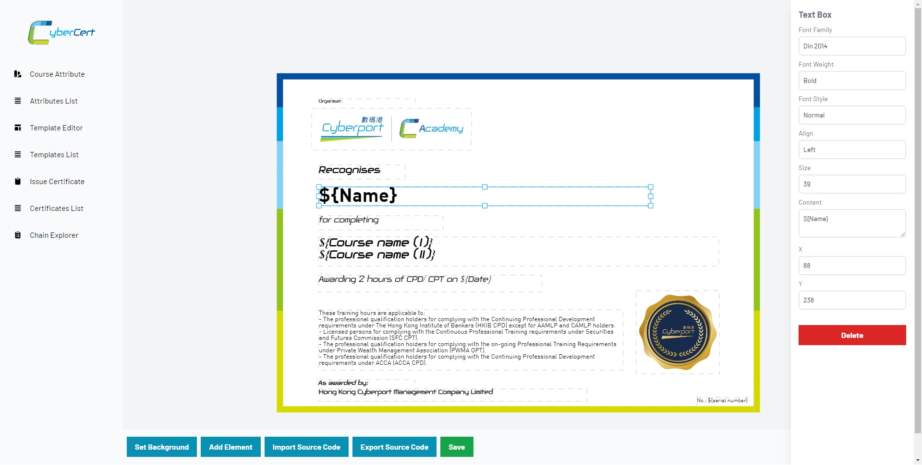
Certificate Template

Slide 13
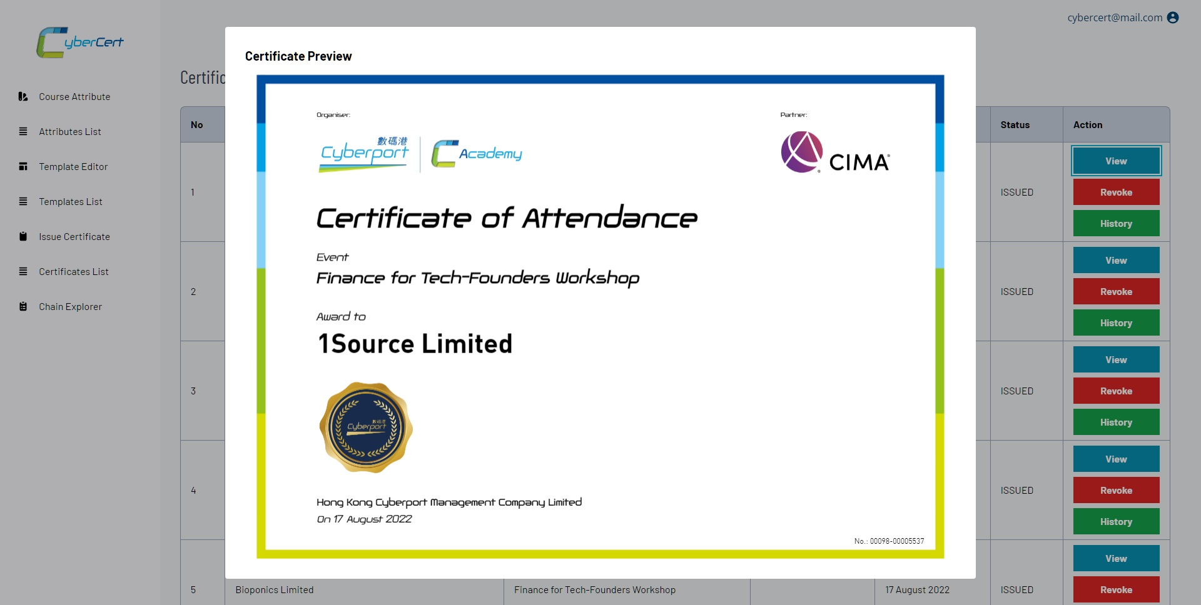
Certificate Preview

Slide 14
Ethereum
Proof-of-Work (PoW) to Proof-of-Stake (PoS) in 2022.
In PoS, instead of mining, user vote for validator to propose the block.
Block is produced in 1 slot.
In each slot (12 seconds), one validator is randomly selected to be a block proposer, who can create new block.
In each slot, a committee of validators is randomly selected, who vote to support/deny validity of the block.
1 epoch = ~32 slots = 6.4 minutes.
Transaction finality takes 2 epochs (~13 minutes).
Q: why not make it faster block time?

Slide 15
Ethereum Accounts
There are 2 types of Ethereum account:
Externally-owned account (EOA)
Account controlled by public/private keypair.
Contract account
Account of contract deployed to Ethereum network.
Doesn’t have private key. Controlled by logic of smart contract code.
Example: multi-signature wallet
Multi-signature wallet
Wallet with multiple owners
To perform operation such deposit and withdraw, require N of M signatures (approval) for owner to execute. Example: Withdraw 1 ETH require 3 signatures from available 5 owners.

Slide 16
Gas
Gas refers to the unit that measures the amount of computational effort required to execute specific operations on the Ethereum network.
The gas fee is the amount of gas used to do some operation, multiplied by the cost per unit gas. The fee is paid regardless of whether a transaction succeeds or fails.
With gas, it will prevent infinite loops and computational waste.

Slide 17
Smart Contract
Small, autonomous application run on Ethereum Virtual Machine (EVM)
Programming language:
Solidity (C++, Javascript-like)
Vyper (Python-like)
The smart contract code will be interpreted into machine code that can be execute by EVM.
Executing the code will incur additional gas (unit) in transaction.
Smart contract has function and storage.
Q: what are smart contract limitations?
A: One of limitations, smart contract cannot read/access external information (today’s weather, stock price, etc).

Slide 18
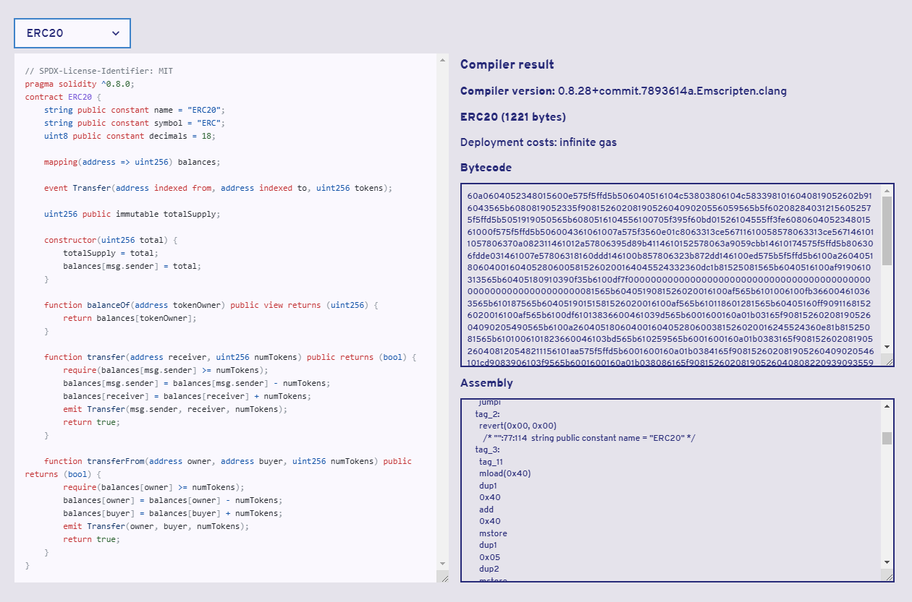
Smart Contract: Example

Slide 19
Smart Contract: ERC-20
ERC-20 is standard of fungible token contract.
ERC-20 token doesn’t have real value until listed on crypto exchange
Why use standard? Interoperability
Token can be listed in multiple crypto exchange.
Seamless contract to contract interaction.

Slide 20
Smart Contract: Oracles
By default, smart contract cannot read off-chain (external) information (weather, stock price, etc) to process.
Oracles source off-chain information to allow smart contract to use external information.
Example: Polymarket
Prediction market for betting on future events.

Slide 21
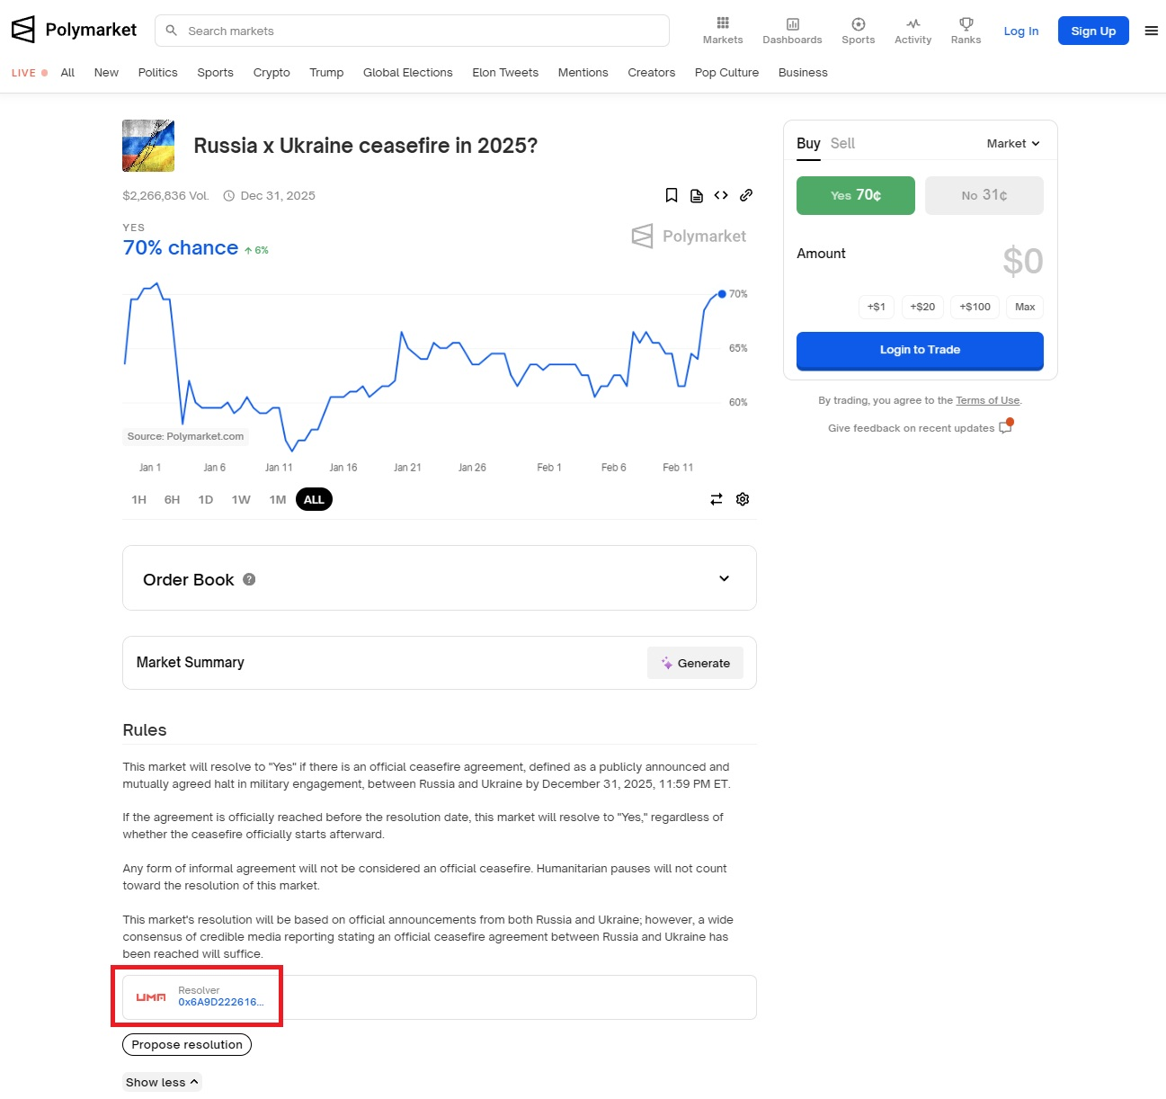

Slide 22
Mini Workshop: Using Blockchain Explorer with Etherscan
Introduction of features and network (mainnet, beacon chain, and test-net)
Read basic transaction information: tx status, gas, calldata
Read public smart contract

Slide 23
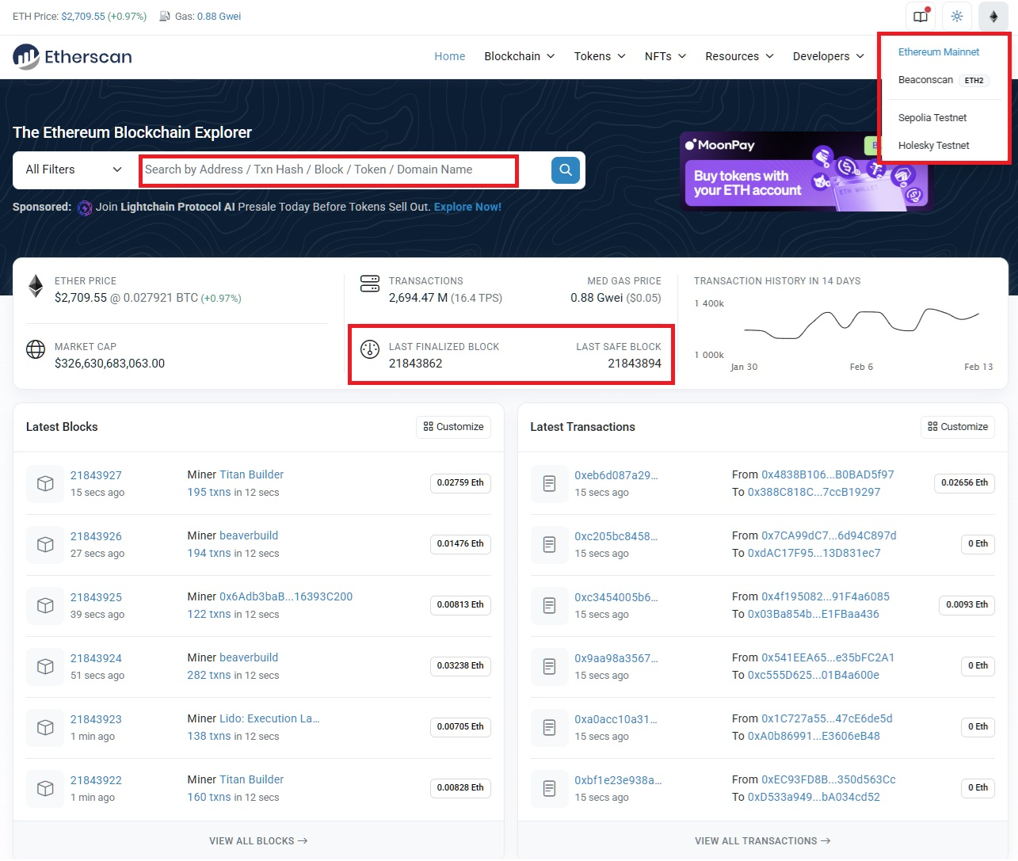

Slide 24
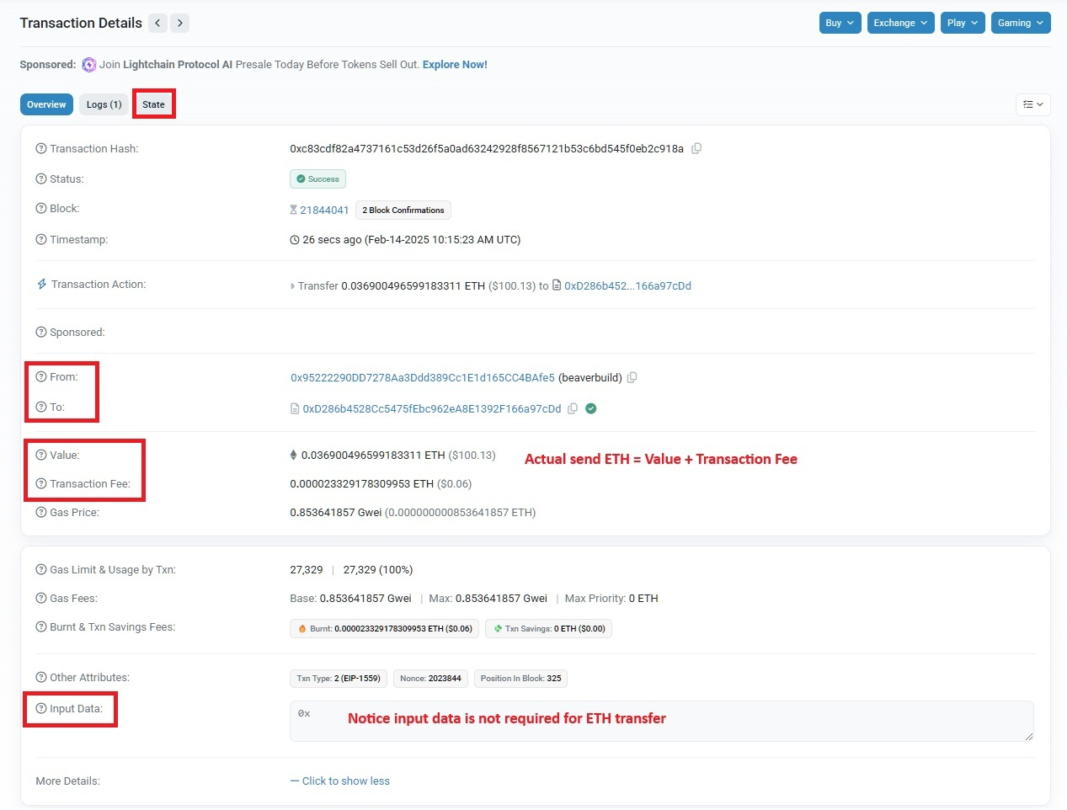
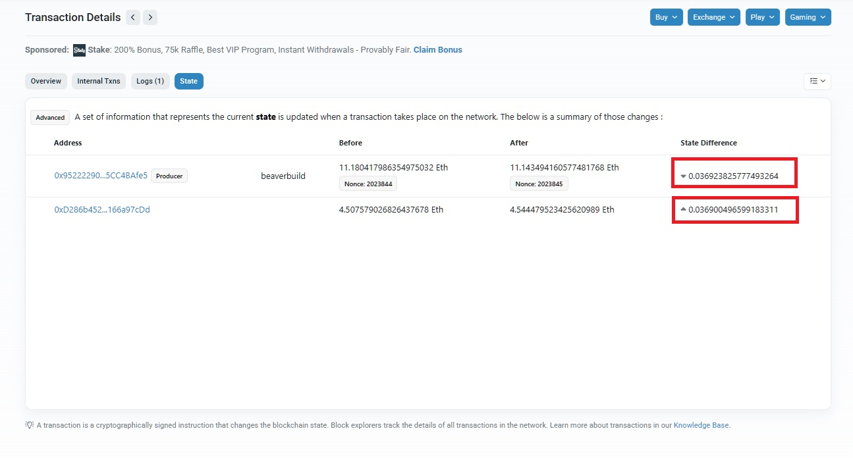
Transaction: Send ETH

Slide 25
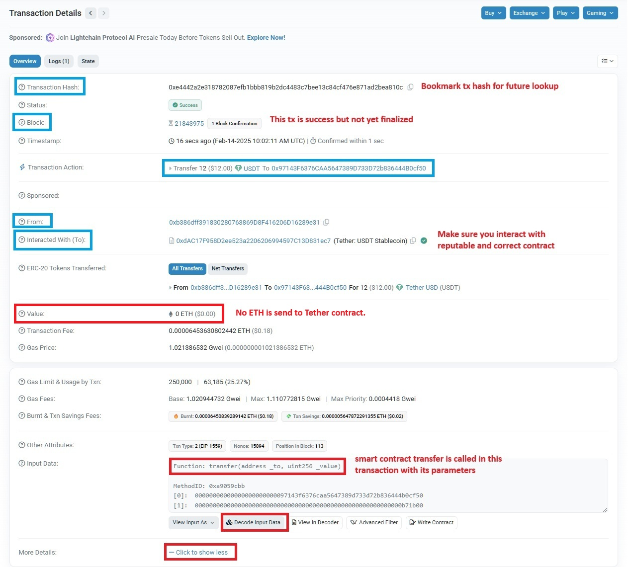
Transaction: Interact with Contract

Slide 26
Exercises: Blockchain Explorer
How to find genesis transactions?
Genesis transaction is first transaction on blockchain
Which address hold most of Tether USDT token?
Tether USDT is ERC-20 for stablecoin
Stable coin is token that value pegged to real asset, in USDT 1 token = $1.
How to get first transaction of Tether USDT?

Slide 27
Refences
https://ethereum.org/en/developers/docs/consensus-mechanisms/pos/#transaction-execution-ethereum-pos
https://ethereum.org/en/developers/docs/oracles/

Slide 28
Q&A
Questions?

